Slide 1
Bots Overview
Rodrigo Souza
Senior Data Scientist
LearnAI Team
Microsoft Cloud & AI

Slide 2
Explosive growth (Nov 2018)
10,000,000+ messages/day
1,000,000+ unique users/day
100,000+ developers
10,000+ active bots
1,000+ companies
100+ new features today

Slide 3





Why a bot?
TYPE
TALK
TAP
Bot builder
Cortana
Facebook Messenger
Skype
Platform services
Intelligent tools
Bing
Notes:
More natural human / computer interaction
Appealing. Efficient. Easy. Natural.
Adapts to the user depending on circumstance
Available where you are (Web, Mobile, Car, Desktop, …)

Slide 4
Kinds of bots 1,000+ companies engaging us
Scenario | Retail | Finance | Insurance | Telecoms | Government | Automotive | Manufacturing | Healthcare | Media | Events
Customer service | ✔ | ✔ | ✔ | ✔ | ✔ | ✔ | ✔ | ✔ |  | ✔
Customer retail | ✔ | ✔ | ✔ | ✔ |  |  |  | ✔
Audio/speech analysis | ✔ | ✔ | ✔ | ✔ | ✔ |  |  |  | ✔
Translation |  | ✔ | ✔
Surveillance |  | ✔ |  |  | ✔
Knowledge extraction |  | ✔ | ✔ | ✔ |  |  | ✔
Video/photo analysis |  | ✔ |  |  | ✔ |  |  |  | ✔
Product identification | ✔ |  |  |  |  |  | ✔ | ✔
Digital assistant |  |  |  |  |  | ✔
Footfall analysis | ✔ |  |  |  |  |  |  |  |  | ✔
HD maps and object detection |  |  |  |  |  | ✔

Slide 5


What is a bot?
Platform
Platform services
HTTP
AI
{ Your Code }
Intelligent tools
REST Endpoint
SDK
Bot builder SDK
REST endpoint
Direct Line Protocol
Conversational and business logic
Canvas aware
Context sensitive

Slide 6


What is the Bot Framework?
http://aka.ms/LearnAI-daaia
Build and connect intelligent bots
The bot framework provides tools and resources for designing, building, deploying, and managing bots
Network of Microsoft customers
Bots connect to Microsoft properties, such as Cortana, LinkedIn, Skype, and Office 365

Slide 7
What is the Bot Framework?
Azure Bot Service:
Bot Framework SDK for developing bots
Bot Framework Tools to cover end-to-end bot development workflow
Bot Framework Service (BFS) to send and receive messages and events between bots and channels
Bot deployment and channel configuration in Azure
Additionally, bots may use other Azure services, such as:
Azure Cognitive Services to build intelligent applications
Azure Storage for cloud storage solution

Slide 8



What is the Bot Framework?
What?
Tools for building REST endpoints
Services to enrich
Mechanisms for receive events
Data to debug and tools to analyze
How?
Implements standard protocols
Modeling conversations is hard; tools help!
UI across multiple canvases is hard; cards rock!
Language understanding is hard, LUIS rocks
Common and well understood patterns
Goals
Start simple; add complexity; no dead-ends
Bot adapts to the user, based on context
Composable and intelligent controls to manage complexity
Customer’s
business logic and data
Bot connector
C#
BOT BUILDER
Bot Controls
Skype
Bing
WebChat
LUIS
Form Filling
QnA
Skype for Business
Cortana
Direct Line
Query over database via Azure Search
Third-party

Slide 9
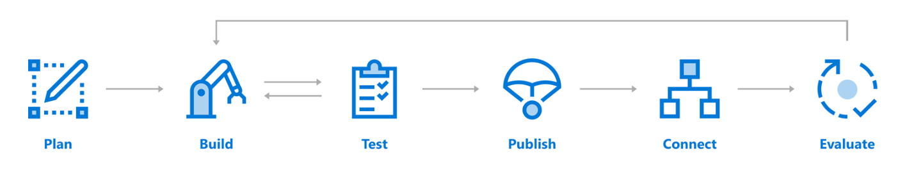
Building a Bot
Azure Bot Service
SDKs exist for C#, JavaScript, and Typescript
SDKs for Java and Python are under development

Slide 10
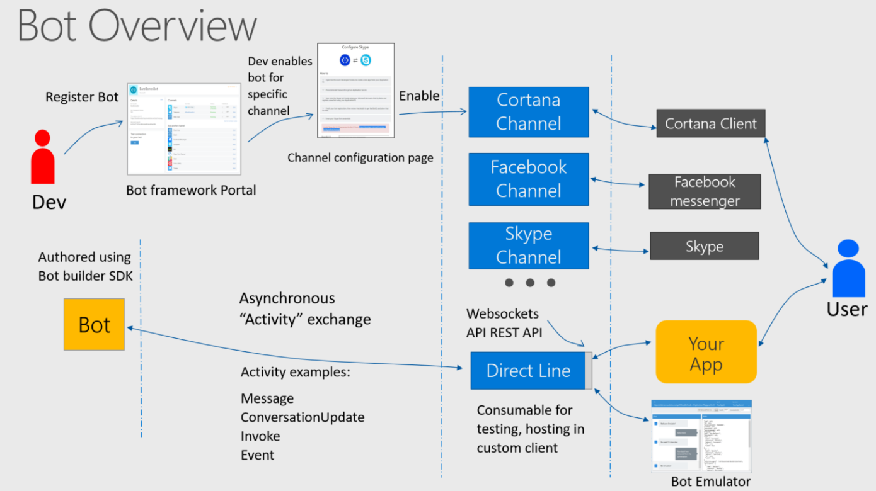
https://blog.botframework.com/2017/06/26/Speech-To-Text/

Slide 11
Key Links for Bots
Scenarios
https://docs.microsoft.com/en-us/azure/bot-service/bot-service-scenario-overview
Reference Architectures
https://azure.microsoft.com/en-us/solutions/architecture/?product=bot-service

Slide 12
Highlights
Improvements Everywhere!
Bot builder
Platform
Intelligence
SDK updates
Speech support
Improved dialog tools
Debugging improvements
Channel inspector
Improved tooling
New channels
Cortana
Bing
Skype for Business
Adaptive cards
Speech support
Payments
Analytics
Bot controls
Speech support
Cognitive services

Slide 13
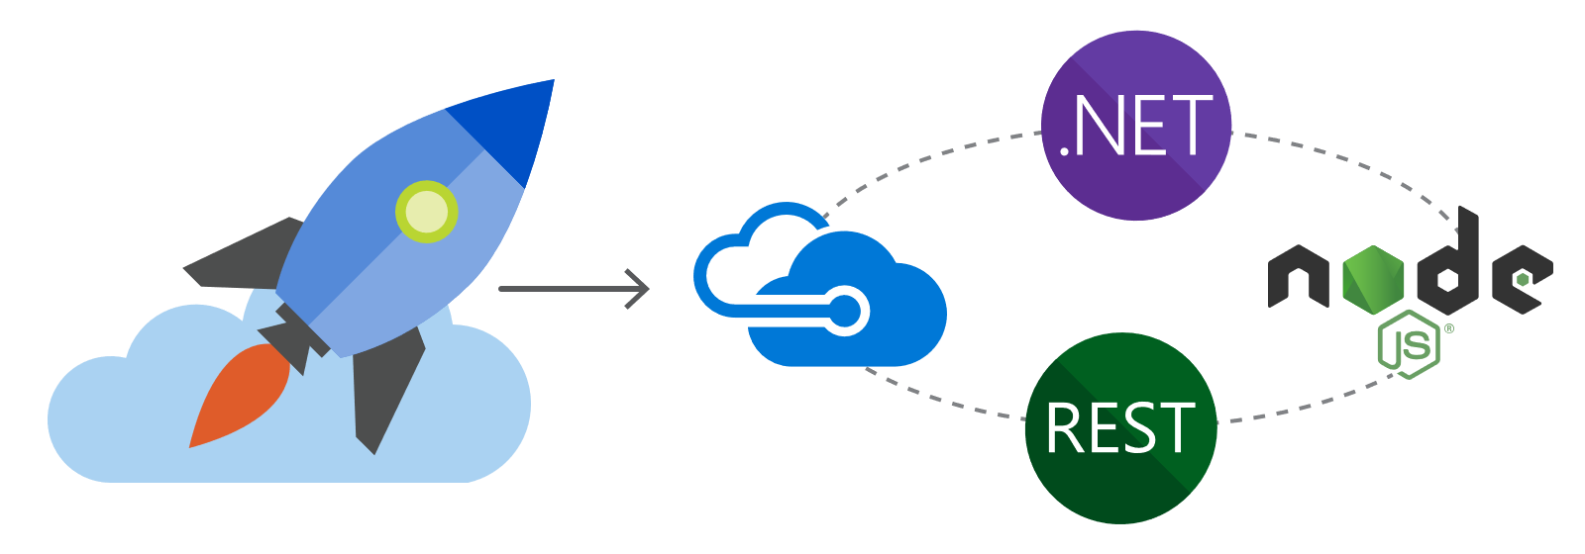
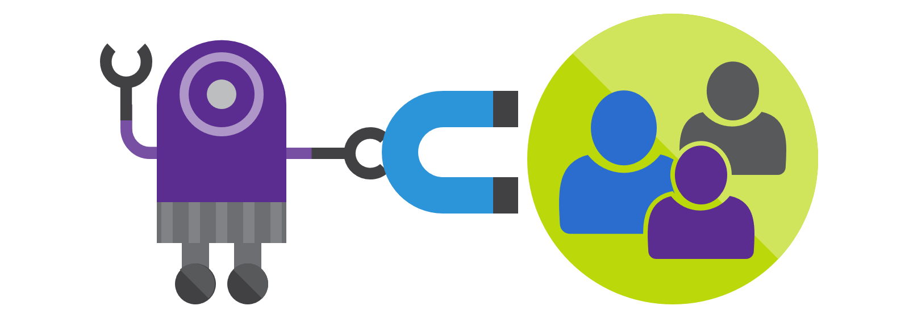
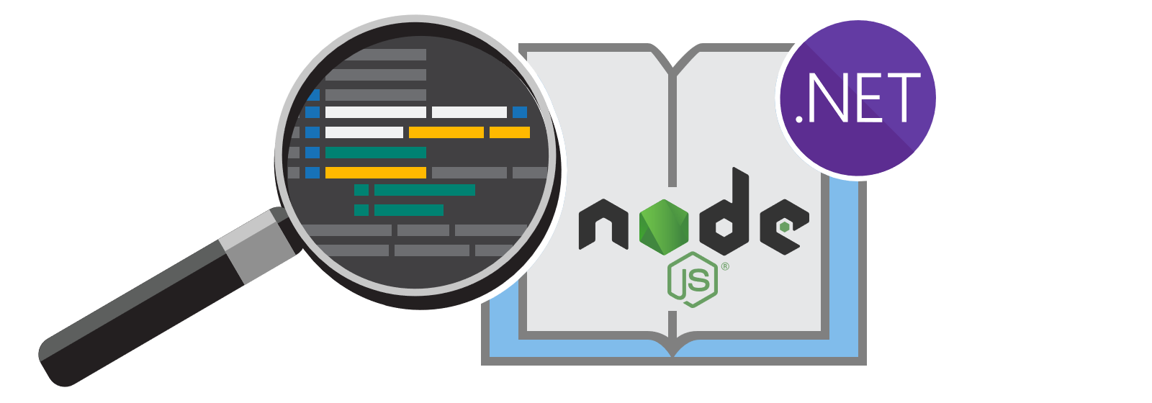
New docs!
#1 Requested Feature
Comprehensive
Bot design
Searchable
Scenario-based
Patterns and practices
Integrated with APIs
Well organized and discoverable
Samples
Easy to read
https://review.docs.microsoft.com/en-us/Bot-Framework/bot-service-concept-intelligence?branch=master
Notes:
https://review.docs.microsoft.com/en-us/Bot-Framework/bot-service-concept-intelligence?branch=master

Slide 14
Demo
New documentation
Intelligent Bots
Notes:
https://review.docs.microsoft.com/en-us/Bot-Framework/index#pivot=main&panel=overview
Show the C#/Node dropdown on:
https://review.docs.microsoft.com/en-us/bot-framework/nodejs/bot-builder-nodejs-dialog-manage-conversation
Show filtering. For example, “Dialog”.
Show the dark theme.
Show the site is responsive.
Show the Adaptive Card help:
https://review.docs.microsoft.com/en-us/bot-framework/dotnet/bot-builder-dotnet-add-rich-card-attachments#a-idadaptive-carda-add-an-adaptive-card-to-a-message

Slide 15











New channels
Improvements Everywhere!
One Bot
Multiple canvases

Slide 16



New channels
One Bot
Multiple CHANNELS
Custom skills
Business bots
LOB bots
Memory/profile
Top bots
IT managed
Speech
Bots in Bing search
Integrated auth

Slide 17
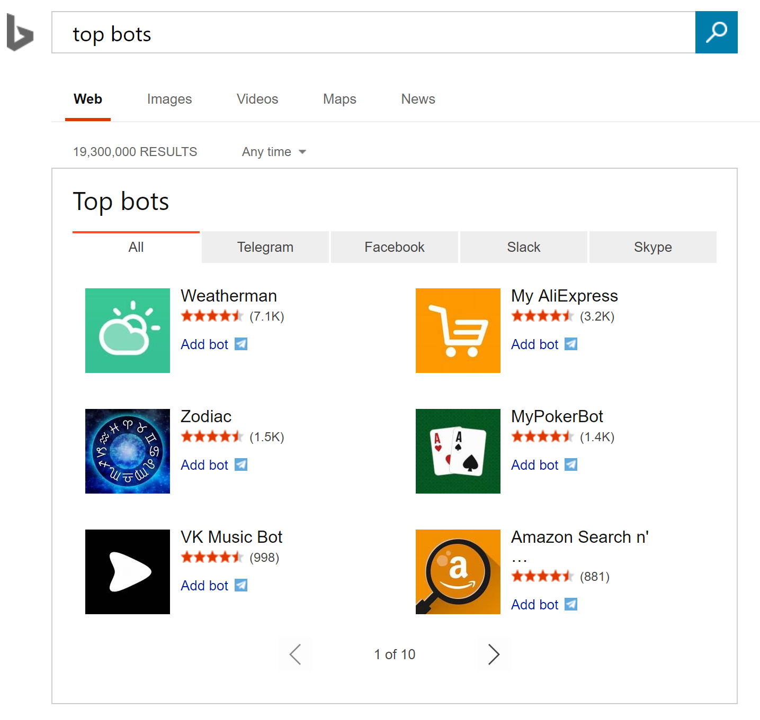
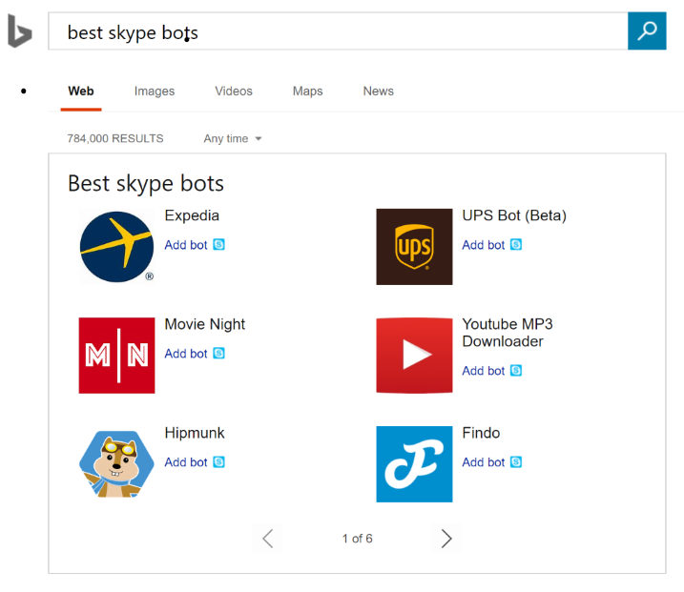
Bot discovery
Bing Search for Bots
Bing Search Terms
Top bots
Top Skype bots
Famous Skype bots
Best Facebook bots
Latest Slack bots

Slide 18
Bot discovery
Bing Search for Bots
Demo - Bots running in Bing Search results
https://www.bing.com/search?q=moksha%20Bellevue
Top Bots
https://www.bing.com/search?q=top+bots&go=Search&qs=ds&form=QBRE
Notes:
Moksha Bellevue Link:
https://www.bing.com/search?q=moksha%20Bellevue
Contoso Cafe
https://www.bing.com/search?q=da9c224c-5e2a-4d10-8ea1-a78c8394d403contosocafebuildbot1+bot&setflight=chtbotans
Find café locations
Here are things you can say
Find café locations near me
Where can I get coffee
Find café locations in <city>
Book a table
Here are things you can say
Book a table
book a table for 2
book a table for 2 in redmond
book a table for 2 in redmond for next Thursday 3 PM
At any turn of the conversation, you should be able to provide additional information or correct a previously provided value
User: Book a table for 2 at redmond for next Thursday 3 PM
Bot: Ok, so I've got a table for 2 at Redmond, WA for 18 May at 3 PM. Is that right?
User: no make it seattle and for 4 guests
Bot: You bet, so I've got a table for 4 at Seattle, WA for 18 May at 04 AM. Should I go ahead?
…
Get help
Here are things you can try
Help
What can you do
What can I say
QnA
Here are things you can try
@help who is your ceo?
@help what are your locations?
@help do you have any openings?
Memory
Here are things you can try
Remember redmond as my favorite store
I prefer to get text messages over phone calls

Slide 19

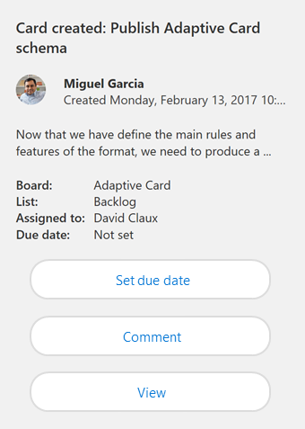
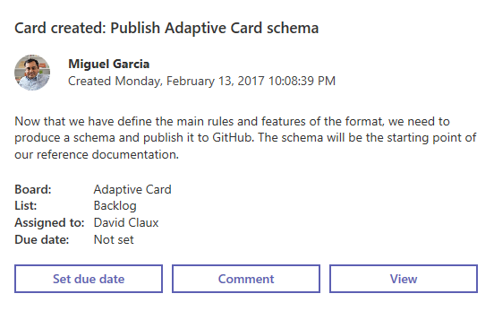
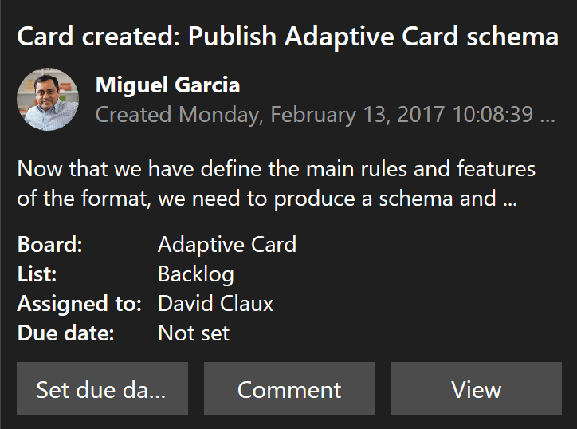
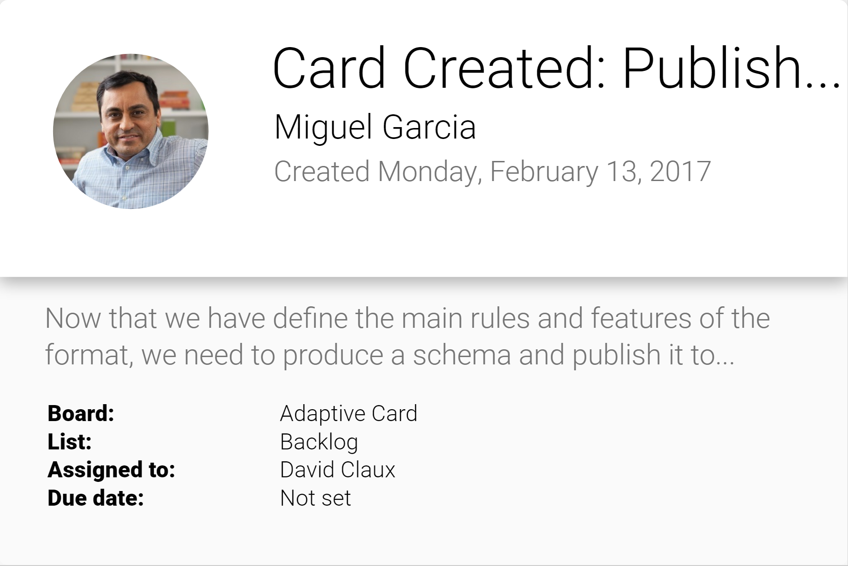
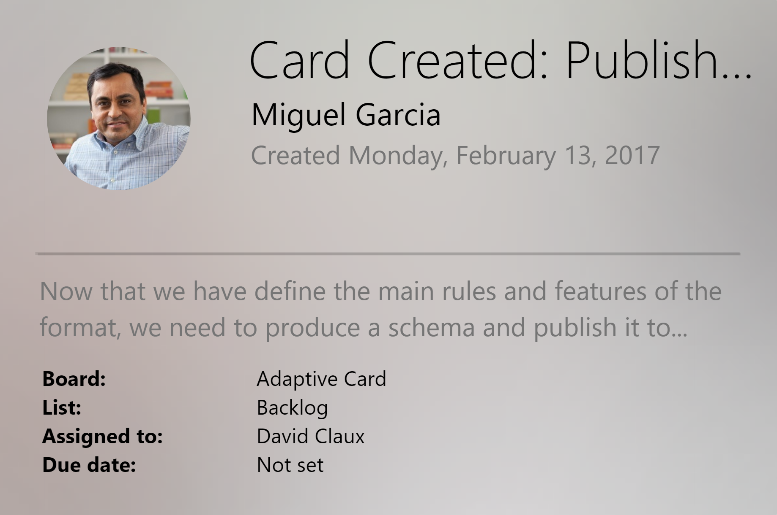
Adaptive cards
Open framework
Multiple CHANNELS
Notification
Microsoft Teams
Skype
Android
iOS

Slide 20
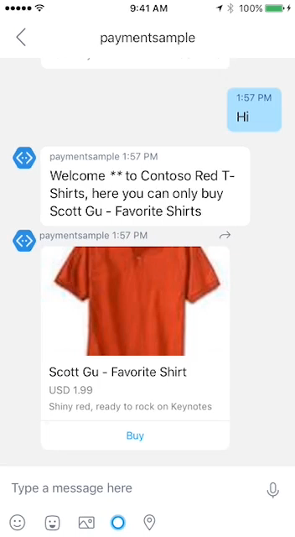
Payments
Stripe is currently supported
Visit Microsoft seller center
Obtain merchant ID
Start building
Works across most major platforms
Fast and simple payment experience
Bring commerce capabilities to your bot
Learn more on Microsoft Seller Center!
Read the integration guide for the bot framework

Slide 21
Speech
Deep Integration
Across the Bot Framework
SPEECH IN PROTOCOLS
SPEECH IN SDKS
SPEECH IN LUIS
DirectLine support
SSML
Modeled conversations
WebChat control
Speech friendly prompts
Common model (Cortana, Bing speech, custom speech recognition)
Cortana
Conversation management
https://blog.botframework.com/2017/06/26/Speech-To-Text/
Notes:
https://blog.botframework.com/2017/06/26/Speech-To-Text/

Slide 22
LUIS
Language Understanding
Top requested features
More new features
Production staging and versioning
More languages (Dutch, Korean, dialects)
Increased intent and entity limits
25 customizable prebuilt domains
Lists
Improved recognizers(*)
Semantic dictionaries
Spell checking
(*) Recognizers are open-sourced

Slide 23
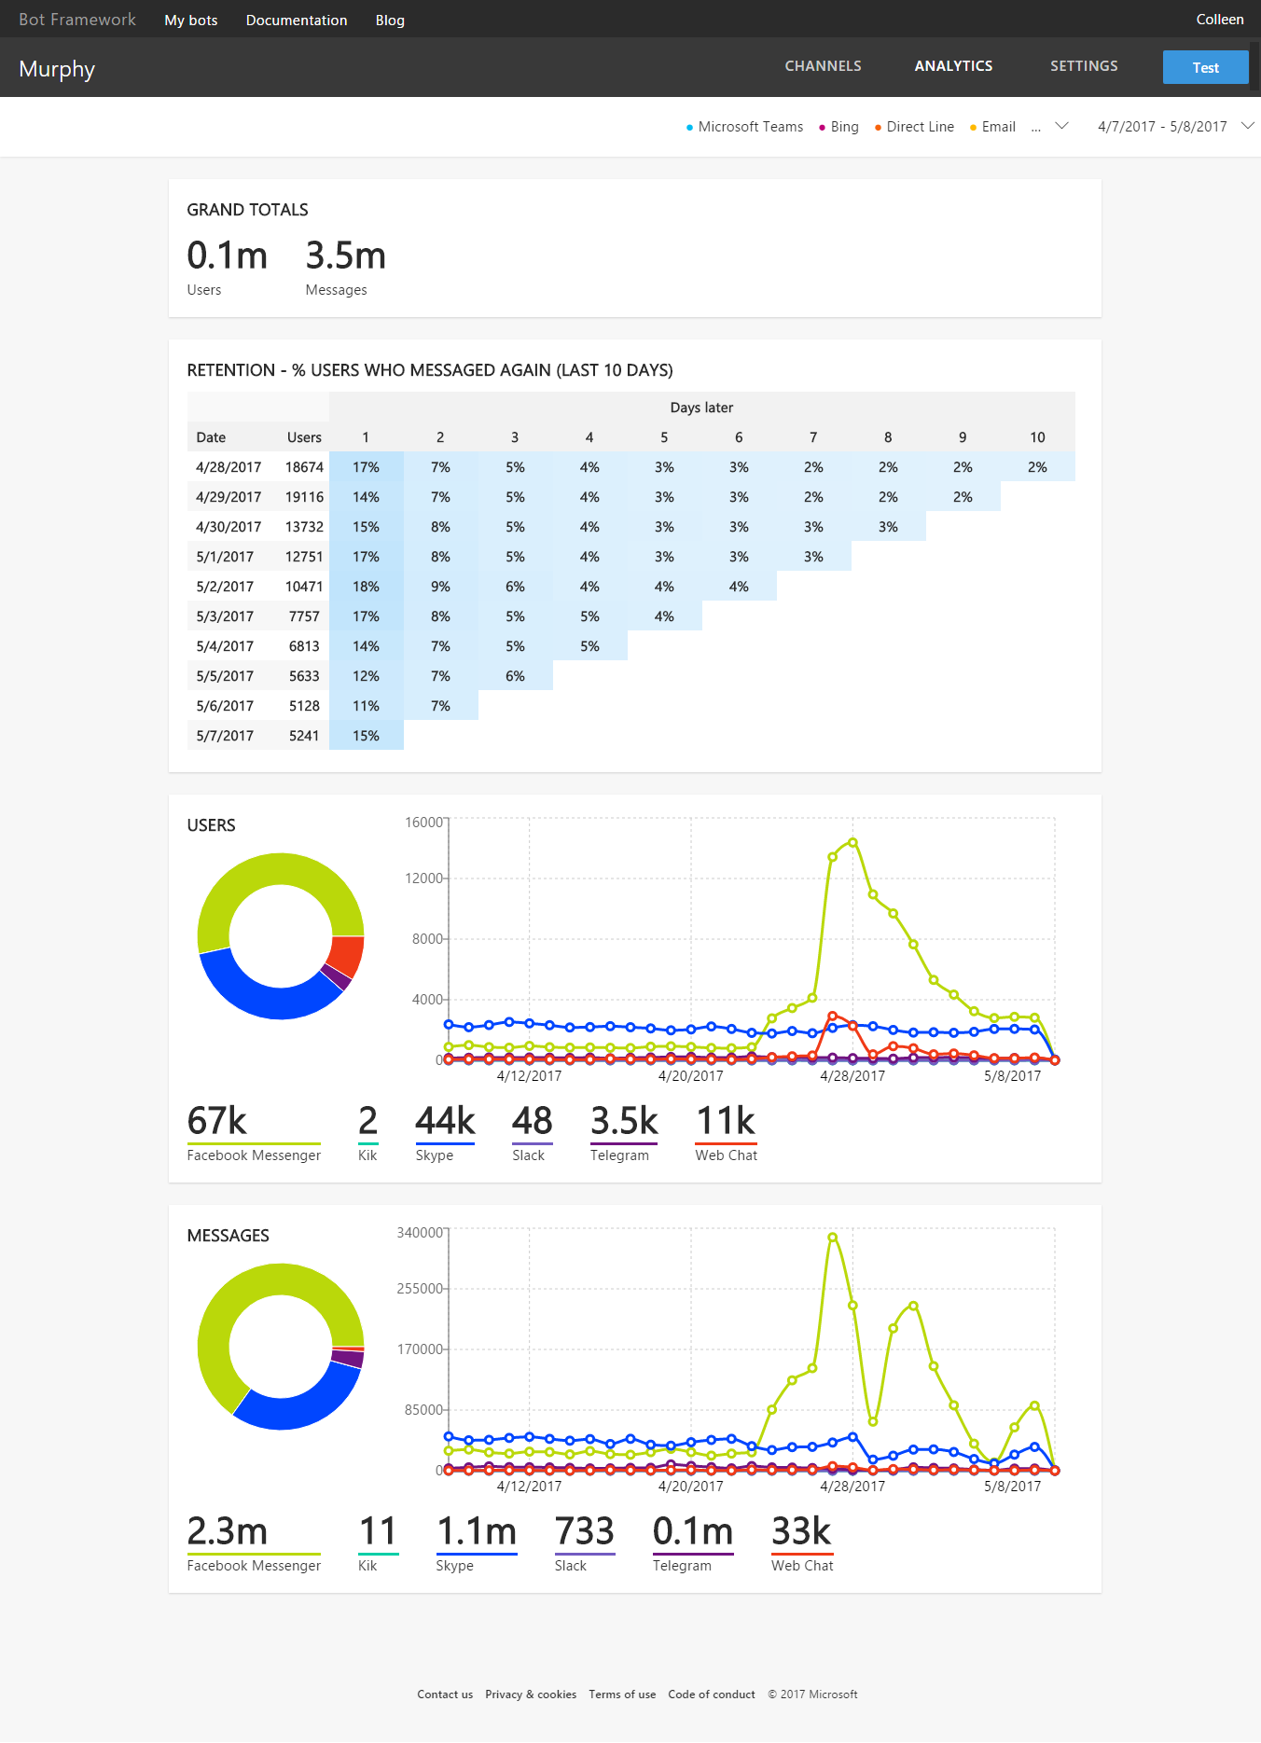
Bot analytics
Application Insights
Bots Logging
http://aka.ms/LearnAI-Ethics

Slide 24
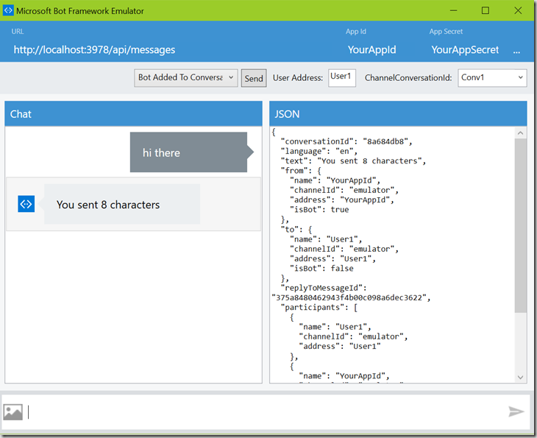
Bot Framework Emulator
Desktop application that allows bot developers to test and debug bots
https://aka.ms/botemulator
You can also use the Web-Chat Portal

Slide 25
Bots State Management
Maintaining state allows your bot to have more meaningful conversations by remembering certain things about a user or conversation.
The SDK includes 3 "buckets":
User state
Conversation state (group or not)
Private conversation state (specific user)

Slide 26
Bots State Management
SDK Storage Options
Memory (data is cleared each time the bot is restarted)
Azure Blob Storage
Azure CosmosDB
For other options, write directly to storage

Slide 27
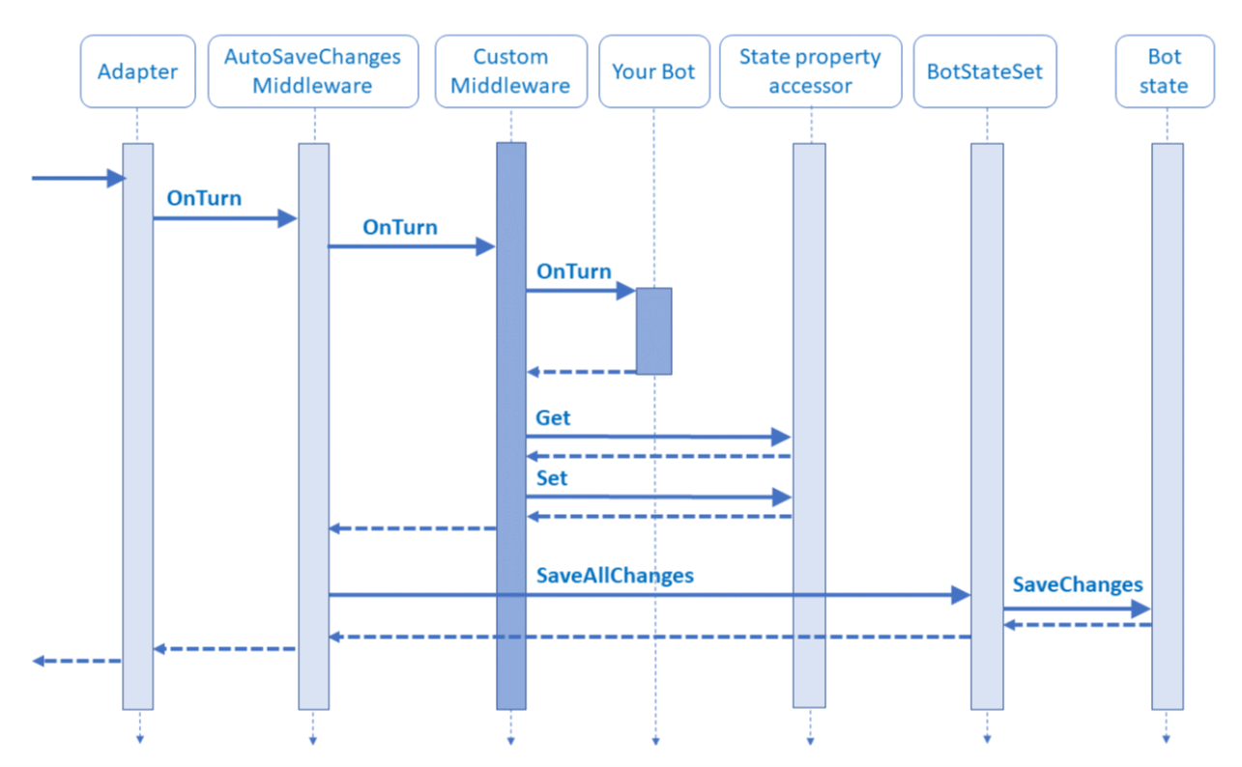
Bots State Management
https://docs.microsoft.com/en-us/azure/bot-service/bot-builder-concept-middleware?view=azure-bot-service-4.0
Notes:
https://docs.microsoft.com/en-us/azure/bot-service/bot-builder-concept-middleware?view=azure-bot-service-4.0

Slide 28
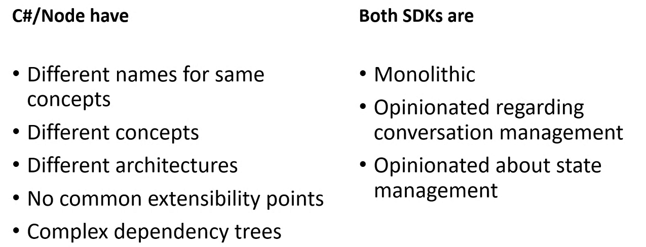
V3 SDK issues
Earlier SDK issues (V0 – V3)
Notes:
Why?
There are two main reasons:
C#/Node.js SDKs in v3 are vastly different. There are different names for the same concepts, different concepts, different architectures, no common extensibility points, and complex dependency trees.
Both SDKs are too opinionated, regarding conversation management and state management.

Slide 29
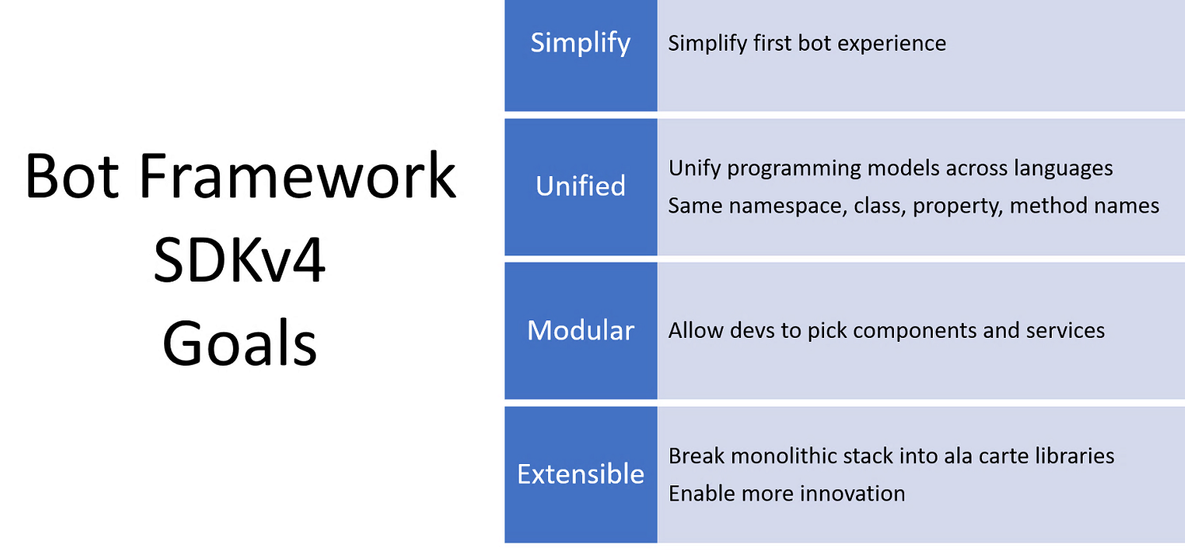
V4 SDK goals
V4 – Actual Version
Notes:
So, as you might've guessed, the Bot Framework v4 SDK had four related goals:
Simplify
Unify programming models across languages
Allow developers to pick components and services
Break monolithic stack into a la carte libraries to enable more innovation

Slide 30
Call to action
Build bots—https://dev.botframework.com/
Docs—https://docs.microsoft.com/en-us/bot-framework/
GitHub—https://github.com/Microsoft/BotBuilder
Continue your education at Microsoft Virtual Academy online
#MSBuild

Slide 31
LearnAI - Designing and Architecting Intelligent Agents http://aka.ms/LearnAI-daaia
To learn more…

Slide 32
https://github.com/Azure/LearnAI-Airlift
Next Lab: Bots

Slide 33
Questions?
rosouz@microsoft.com

